Slide 1
EE 422C
Graphs with
BFS and DFS
EE 422C

Slide 2
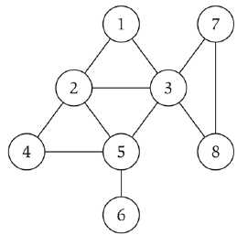
UNDIRECTED GRAPHS
Undirected Graph: G = (V,E)
  V – nodes
  E – edges between pairs of nodes
  Graph size parameters
    n = |V|, m = |E|
EE 422C

Slide 3
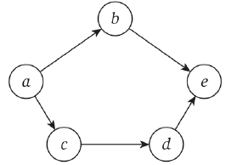
DIRECTED GRAPHS
Directed Graph: G = (V,E)
  V – nodes
  E – edges between pairs of nodes
  Graph size parameters
    n = |V|, m = |E|
EE 422C

Slide 4
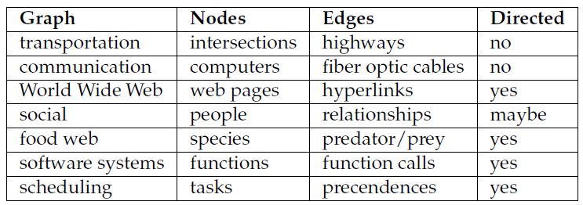
EXAMPLE OF GRAPH APPLICATIONS
EE 422C

Slide 5
GRAPH REPRESENTATION
A common way of representing graph G = (V,E)
  Collection of adjacency lists
    Uses less memory for sparse graphs (m << n²)
EE 422C

Slide 6
ADJACENCY LIST REPRESENTATION
Adjacency List Representation for graph G = (V,E)
  Contains one linked list per vertex
    Array Adj stores the n lists
  For each u ∈ V, Adj[u] is list of vertices v where edge from u to v exists
  Order of lists arbitrary
  For undirected graph, ∑_{u∈V} |Adj[u]| = 2m
  Total memory required to represent graph Θ(n+m)
EE 422C

Slide 7
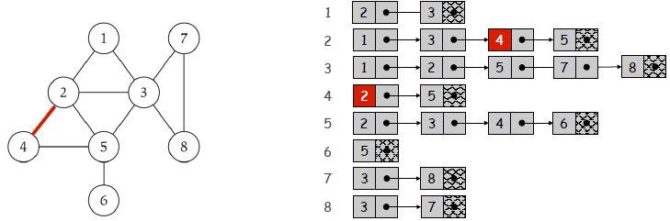
EXAMPLE OF ADJACENCY LISTS
EE 422C

Slide 8
ADJACENCY LISTS
Weighted graphs
  Each edge has associated weight
    w : E → R
  Can easily store w(u,v) in adjacency list representation
Drawback of adjacency lists
  Determining if edge from u to v
    Requires searching u’s entire list
    Expensive if lots of edges
EE 422C

Slide 9
ADJACENCY MATRIX REPRESENTATION
Adjacency Matrix Representation for graph G = (V,E)
  Uses n × n matrix A = (a_{ij})
    a_{ij} =1 if (i,j) ∈ E and 0 otherwise
  Requires Θ(n²) memory
    Regardless of number of edges
  For undirected graph a_{ij} = a_{ji}, so can use half of storage space
EE 422C

Slide 10
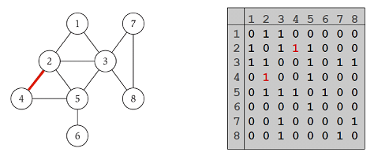
EXAMPLE OF ADJACENCY MATRIX
EE 422C

Slide 11
QUESTION
What is time complexity for checking if edge (u,v) exists in graph
  For adjacency matrix representation
  For adjacency list representation
EE 422C

Slide 12
CONNECTIVITY
s-t Connectivity Problem
  Checking if path exists between s and t
Applications
  Social networks connections
  Maze traversal
EE 422C

Slide 13
BREADTH FIRST SEARCH
Problem
  Given specific source vertex s in graph G = (V,E)
    What vertices can be reached from s
  Important problem frequently used in more advanced graph algorithms
  Need to systematically explore edges of G to “discover” each node reachable from s
Breadth First Search (BFS)
  Expands search for new nodes uniformly across “frontier” of discovered nodes
  Works for both directed and undirected graphs
EE 422C

Slide 14
BREADTH FIRST SEARCH
Breadth First Search (BFS)
  Think of nodes colored white, gray, or black
  Initially all nodes white
  Node “discovered” first time BFS encounters it
    Color node gray
  Complete set of gray nodes is “frontier”
  At each step
    Look at outgoing edges of each gray node
    See if connected to any white (undiscovered) nodes
    If so, color node gray
    After all of nodes outgoing edges examined
      Color black
EE 422C

Slide 15
BREADTH FIRST SEARCH
BFS Intuition
  Explore outward from s in all possible directions
    Adding nodes one at a time
BFS Algorithm
  L₀ = {s}
  L₁ = all neighbors of L₀
  L₂ = nodes not in L₀ or L₁ having edge to node in L₁
  L_{i+1} = nodes not in earlier layer having edge to node in L_{i}
EE 422C

Slide 16
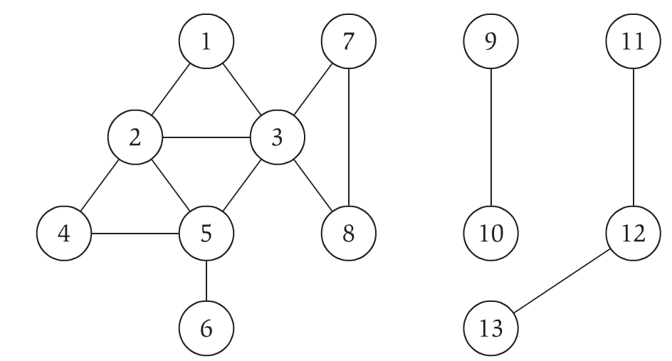
BREADTH FIRST SEARCH EXAMPLE
EE 422C

Slide 17
BREADTH FIRST SEARCH
Can use queue (FIFO) to keep track of “discovered”, but unexplored nodes
Can use adjacency lists to store graph
All nodes initially undiscovered
  Each node discovered at most once
    Queue operations are O(1)
    Time interacting with queue O(n)
  Each adjacency list scanned at most once
    Total time looking at adjacency lists O(2m)=O(m)
Running time of BFS O(n + m)
  Linear in size to adjacency list
EE 422C

Slide 18
SHORTEST PATHS
Shortest-path distance d(s,v) from s to v
  Minimum number of edges in any path from s to v
  If no path from s to v, then d(s,v) = ∞
Level of node in BFS is shortest-path distance from s to u
EE 422C

Slide 19
DEPTH-FIRST SEARCH
Depth-First Approach
  Alternative to exploring across entire frontier at same time
  Explores single path as far as it goes, then explores different one
  Edges exhaustively explored out of most recently discovered vertex v
    Then backtracks and explores other paths from v’s parent
EE 422C

Slide 20
DEPTH-FIRST SEARCH
DFS(u):
Mark u as “Explored” and add u to R
For each edge (u,v) incident to u
If v is not marked “Explored” then
Recursively invoke DFS(v)
EE 422C

Slide 21
DEPTH-FIRST SEARCH EXAMPLE
EE 422C

Slide 22
DEPTH-FIRST SEARCH
DFS implemented with stack (LIFO)
DFS(s):
Initialize S to be stack with one element s
While S not empty
Take node u from S
If u is searched_for_val, return true
If Explored[u] = false then
Set Explored[u] = true
For each edge (u,v) incident to u
Add v to stack S
Return false
EE 422C

Slide 23
COMPARING BFS AND DFS
Similiarities
  Both build strongly connected component of G that contains s
  Both have similar efficiency
Differences
  Explore vertices of G in very different orders
  Result in trees rooted at s with very different structures (bushy vs. tall)
EE 422C

